Slide 1
Dejj Engineering & Investments Solutions
Website Design and Functionality Showcase
By Omiat Jonathan

Slide 2

Homepage

Slide 7

About Us

Slide 10
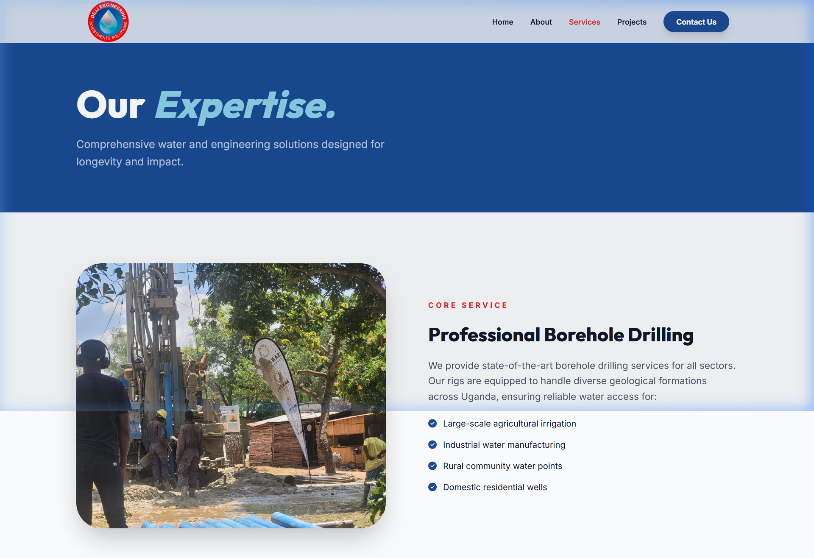
Our Services

Slide 11

Projects

